Slide 1
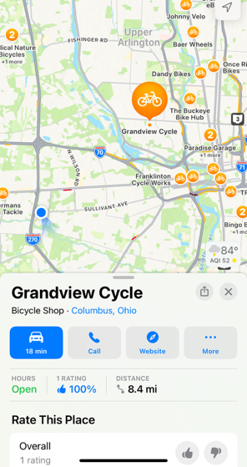
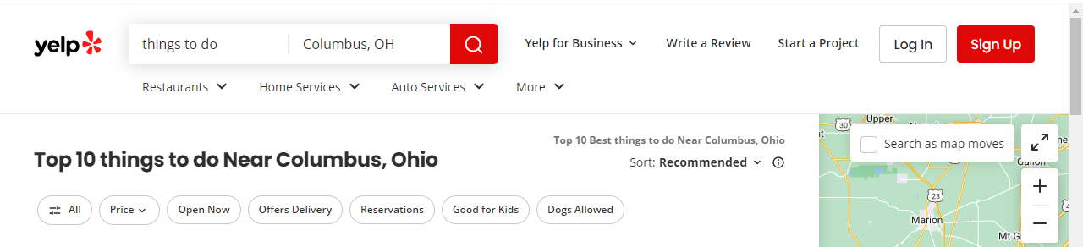
Team museum Art badgers
Determined the project object: TripAdvisor-like app for querying ‘well known’ artists at travel destinations
Decided on artform, initially was painters and sculptors.
Determined the definition of ‘well-known’ or ‘popular’ art.
artwolf.com
ranker.com
mymodernmet.com
Located sources of art, i.e., museums
Each of us selected a region within the Midwest
Saritha
Renee
Matt

Slide 2
Extract data
ETL diagram .. and planning
Museum
Project 3
museums
API call
Transform data
Load data
Data
cleaning
Direct download
pgAdmin
PostgreSQL
Data
conformity
End-user
Beautiful Soup
dataframe
&
.csv
Direct data entry via a form
Filter:
museum v.
top artists
pretty spreadsheets
Interactive webpage
website
top lists
Theartwolf
ranker
A chicken crossing the road is poultry in motion.

Slide 3
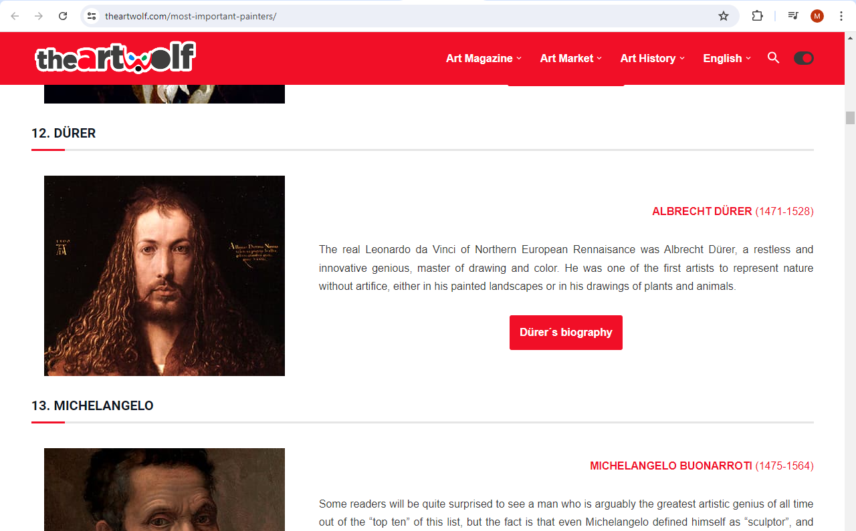
Top Lists
theartwolf.com
Splinter
Beautiful soup
Regular expressions
pandas – lots of data cleaning, merging df, etc.
ranker.com
mymodernmet.com
Output was .csv file that was passed to each museum
Yes, this is subjective, but could also be educational to some.
The hardness of the butter is proportional to the softness of the bread.

Slide 4
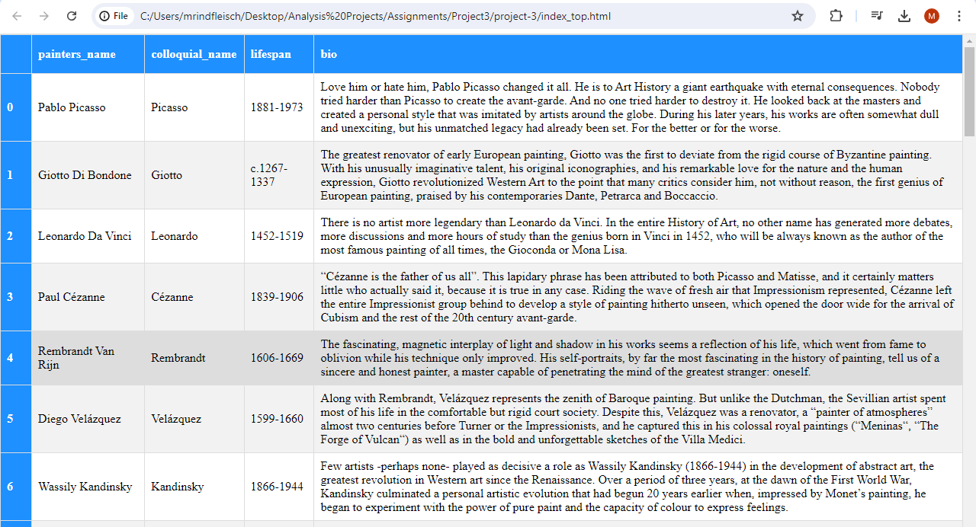
Top Lists
An html file was crafted:
Becoming vegetarian was a huge missed steak.

Slide 5
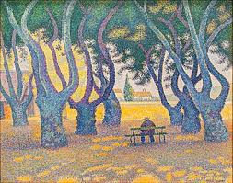
Carnegie Museum of Art
Source: json file via GitHub, ~28,000 works of art
reduced data to 4 different art forms, ~16,000 works
jupyter notebook:
json module
pandas – for loops, data cleaning
Regular expressions
Output: .csv, uploaded in PostgreSQL
Had to clean more, use “|” not “,”
Filter using sql code
using many-to-one relationship (ERD)
Created query (View)
740 pieces of art at Carnegie by “top artists”
If you take your laptop for a run, you jog your memory.

Slide 6
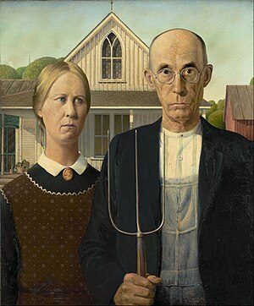
Chicago Institute of Art
Source: data dump from GitHub
Museum discouraged scraping of website
Took over 5 hours to unzip because each piece of art had several json files
> 200,000 pieces of art!
Imported data in Pandas jupyter
Filtered on artist: Reduced file to just under 4000 records
Iterated through the json files to get rest of the data
Saved as CSV file to download to database
Santa's helpers are subordinate clauses..

Slide 7
Code Snippet to extract date from 4000 files
def extract_date_display(row):
id = row['id']
filename = f"{id}.json" #JSON files are named after the artwork id numbers
file_path = os.path.join(r'api-data\json\artworks', filename)
if os.path.exists(file_path):
with open(file_path) as json_file:
data = json.load(json_file)
date_display = data.get('date_display')
return date_display
else:
return None
# Add creation_date to dataframe
merged_df['creation_date'] =merged_df.apply(extract_date_display, axis=1)

Slide 8

Cleveland Museum of Art
Source data: json data via GitHub, 65,000 records
Imported data in Mongo db
Filtered the data that has no artists names
Converted the json file to dataframe
Extract the artist name from the tombstone field
Example: tombstone ="Fishmarket, 1902. Camille Pissarro (French, 1830â€“1903). Oil on canvas; unframed: 66 x 81.3 cm (26 x 32 in.). The Cleveland Museum of Art, Nancy F. and Joseph P. Keithley Collection Gift 2020.113“
Merged museum and ‘top artists’ dataframe for filtering
Convert filtered data to csv file
A boiled egg in the morning is hard to beat.

Slide 9
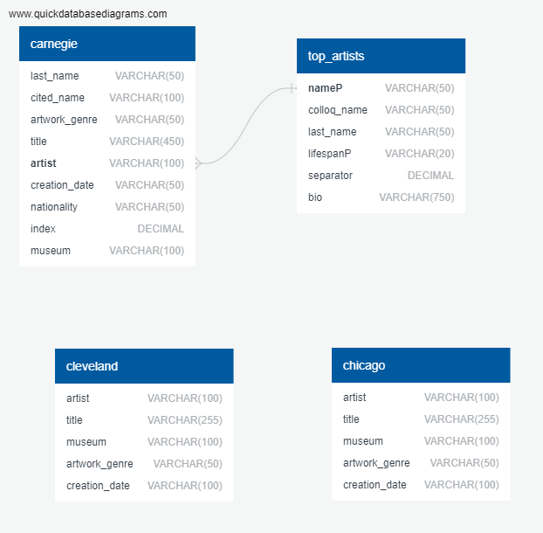
Create PostgreSQL database
Filtered Carnegie data using JOIN ... ON
Cleveland and Chicago tables merged with Carnegie VIEW using UNION
New VIEW containing all 3 museums
When everything is coming your way, you’re in the wrong lane.

Slide 10
Final output
Panda dataframe and csv.file of combined data from all three museums:
Postgres database ‘art’ with custom Views of each museum and combined data
Pretty formatting of large sets of data:
stand-alone displaying top artists
CSV convertor
Render CSV:
Flask, render template modules
Accesses and formatting
<textarea class="form-control“
<table id="proxies" class="display table nowrap responsive"
<!DOCTYPE html>
Borrow money from pessimists – they don’t expect it back.

Slide 11
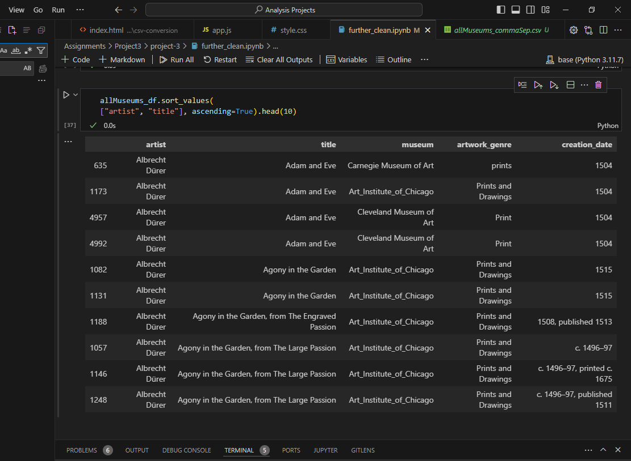
Final output: dataframe
Output of combined data as a dataframe:

Slide 12
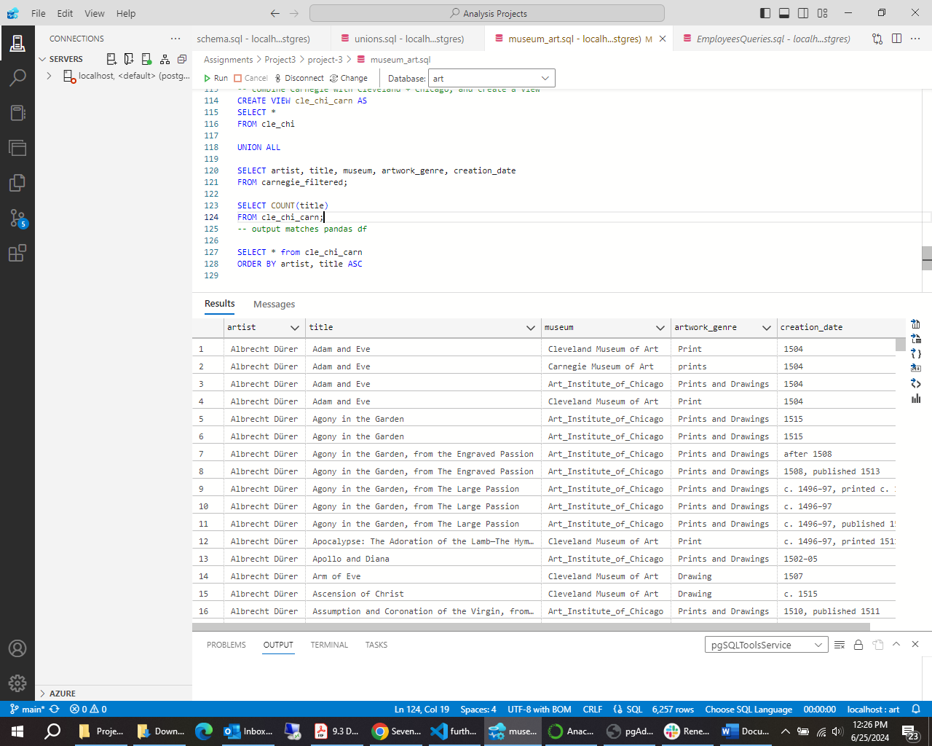
Final output: sql db
Output of the sql VIEW ‘cle_chi_carn’:

Slide 13
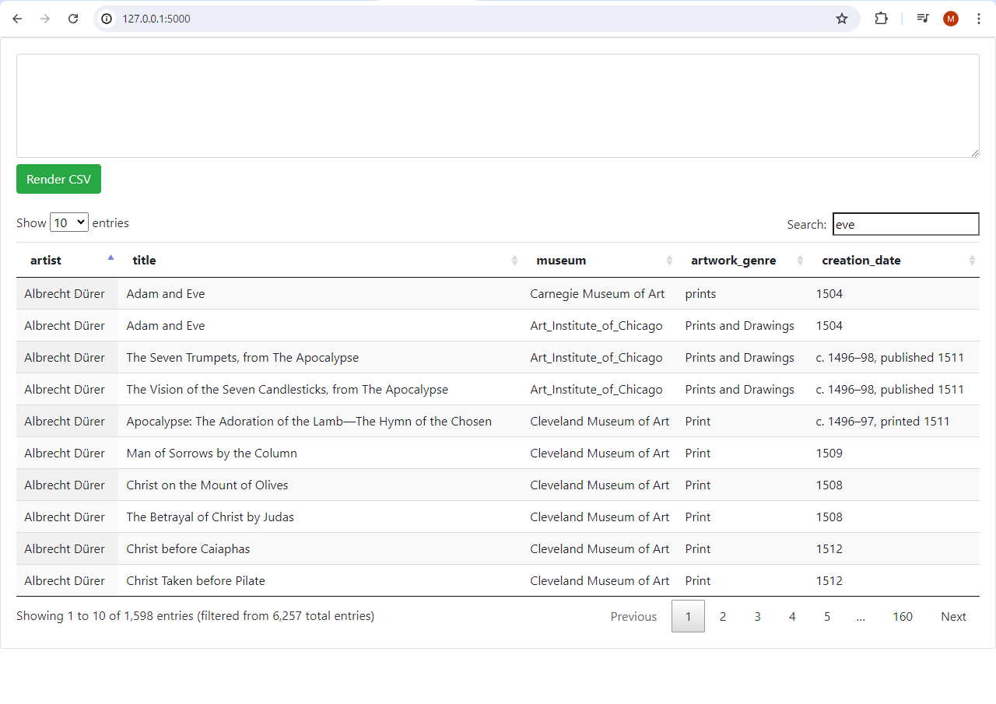
Final output: pretty table view
.html and .css files:

Slide 14
Next steps:
Add more museums
Add other forms of art
Review non-conformity issues of artist names…
Jean Auguste Dominique Ingres or Jean-Auguste-Dominique Ingres
Willem de Kooning or Willem De Kooning
Edouard or Édouard
Possibly reduce number of artists considered ‘the best’, or let the user decide the filter
Create a webpage for both PC and iPhone
A conclusion is the place where you got tired of thinking.

